Slide 1
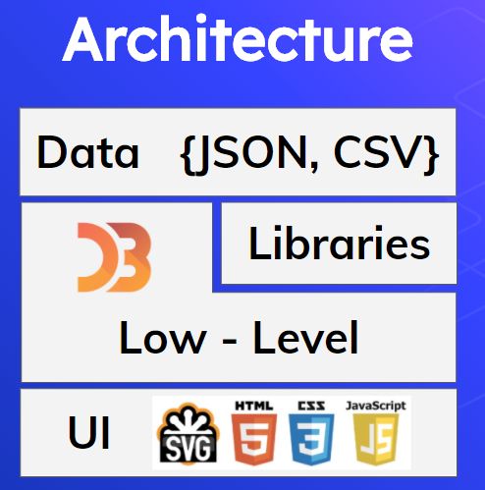
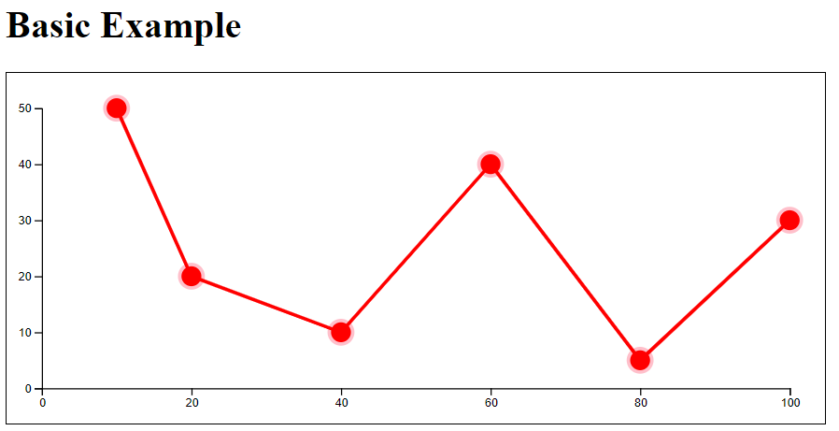
D3JS
Nishita Aishwarya (2018450001), Hammad Ansari (2018450002), Maulika Arekar (2018450003), Diksha Bandagle (201845002)
Introduction
Getting Started
Summary
D3.js is a JavaScript library for manipulating documents based on data
D3 helps you bring data to life using HTML, SVG, and CSS
D3.js is extremely fast, responsive and supports large data sets too for creating dynamic animations in web browsers.
The collection of useful coding components & plugins make d3 codes reusable.
Importing D3: first step is to import D3 library through scripting tag.
Creating simple SVG: Creating an SVG would give us space to work with data.
Setting up our variables: Creating or importing our dataset to perform operations or use it for plotting graphs in our project
Select(): The d3.select() function in D3.js is used to select the first element that matches the specified selector string. If any element is not matched then it returns the empty selection. If multiple elements are matched with the selector then only the first matching element will be selected.
Select All(): The d3.selectAll() function in D3.js is used to select all the element that matches the specified selector string.
Axes: The axes renders human-readable reference marks for scales. Graphs have two axes: the horizontal axis or the x-axis and the vertical axis or the y-axis. D3 provides functions to draw axes. An axis is made of lines, ticks and labels. An axis uses scale, so each axis will need to be given a scale to work with.
Scale: They map our data values to values that would be better represented in visualizations. D3 provides the following scaling methods for different types of charts.
Line: Generates path data for a multi-segment line (typically for line charts)
Path: Setting up path by appending it to SVG with draw line as a parameter.
D3 allows you to create almost any kind of data visualization product you’ve seen in an application or newspaper or online.
D3 can work on more and more complex data.
Understanding the DOM, SVG, and CSS is necessary for creating complex data visualization products.
D3 data binding allows you to create and remove elements on your web page based on data. It also allows you to change the characteristics of those elements—graphical or text content—based on your data.
Different data types necessitate different approaches to manipulate and visualize them. The main types of data you’ll work with are numerical, hierarchical, topological (network), and textual.
D3’s built in transitions allow for simple, effective animation right out of the box.
Architecture
Data - provided by you ( can be in any format such as CSV, JSON)
Driven - d3 connects data to documents
Documents - builds web based documents
Results
References
https://d3js.org
https://github.com/d3/d3
https://observablehq.com/@d3/gallery
https://github.com/fruxc/d3js

